Slide 1


Slide 2
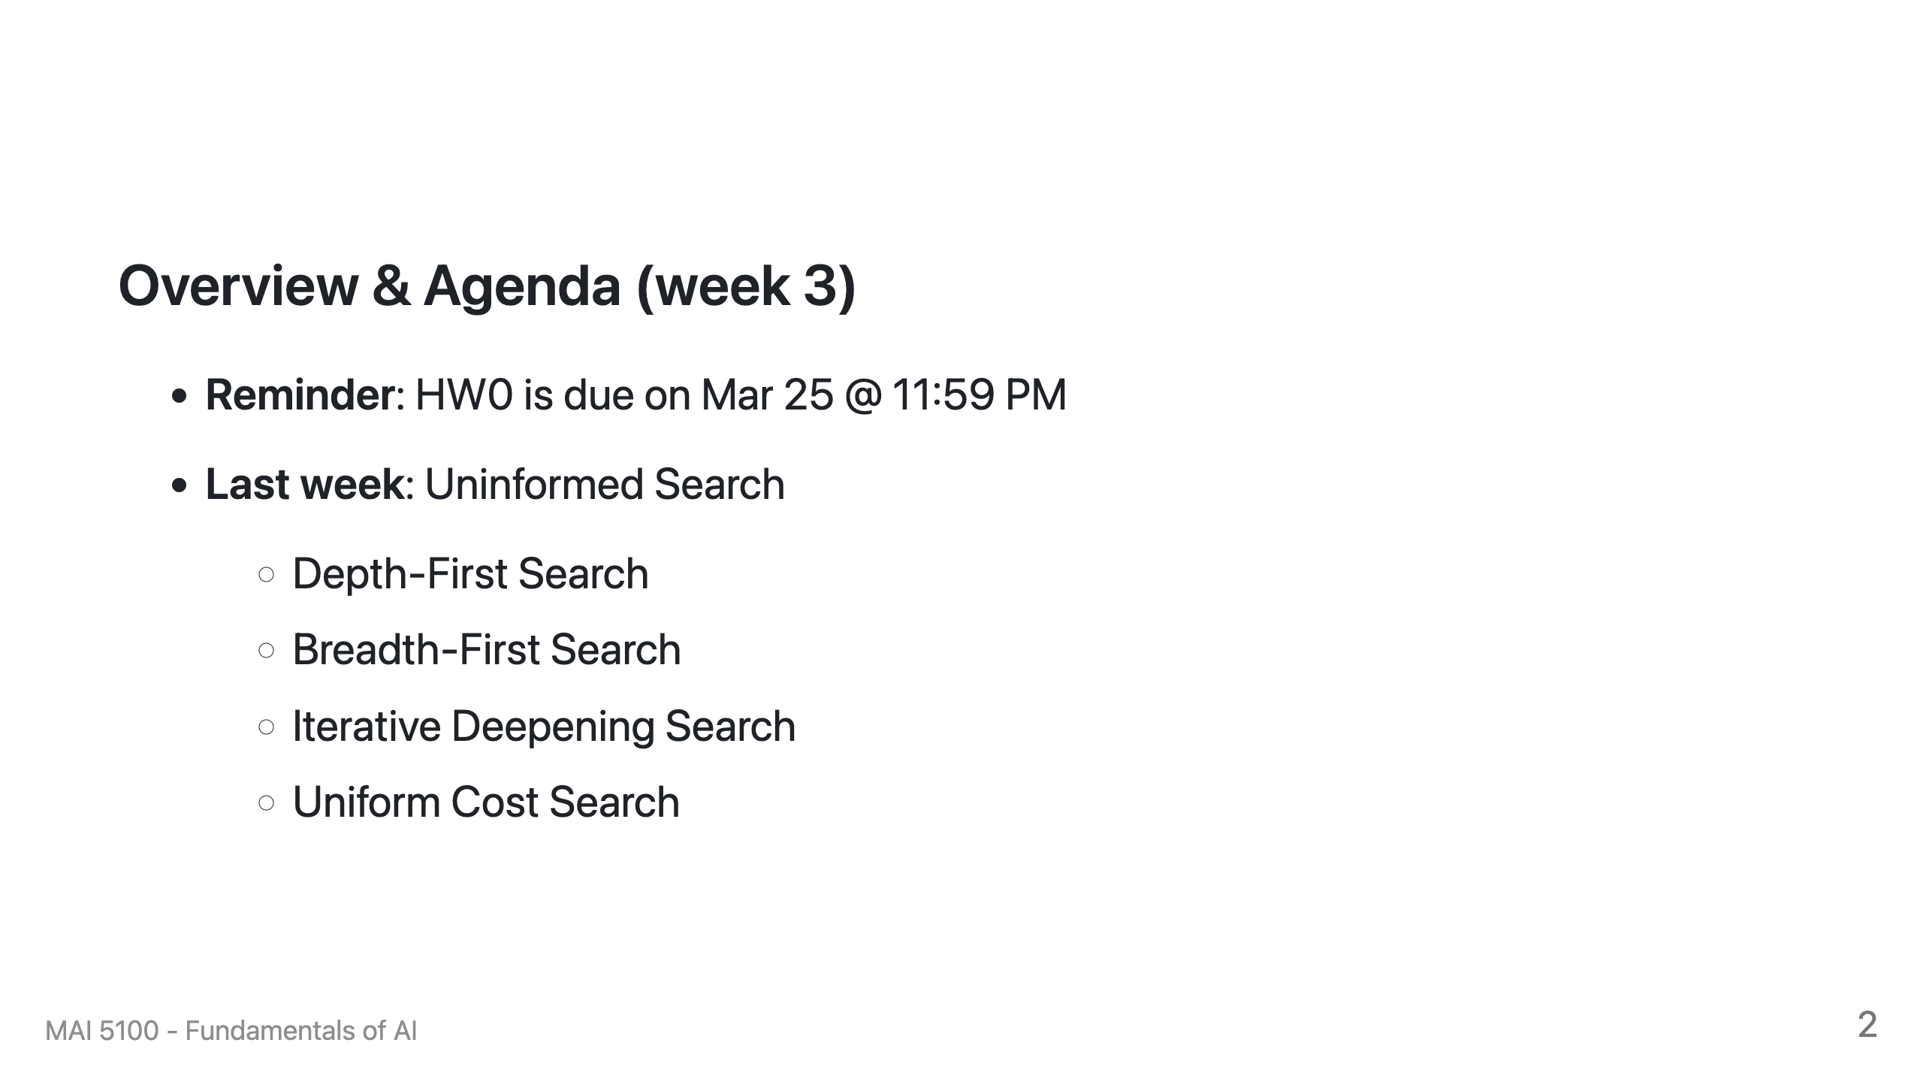

Slide 3
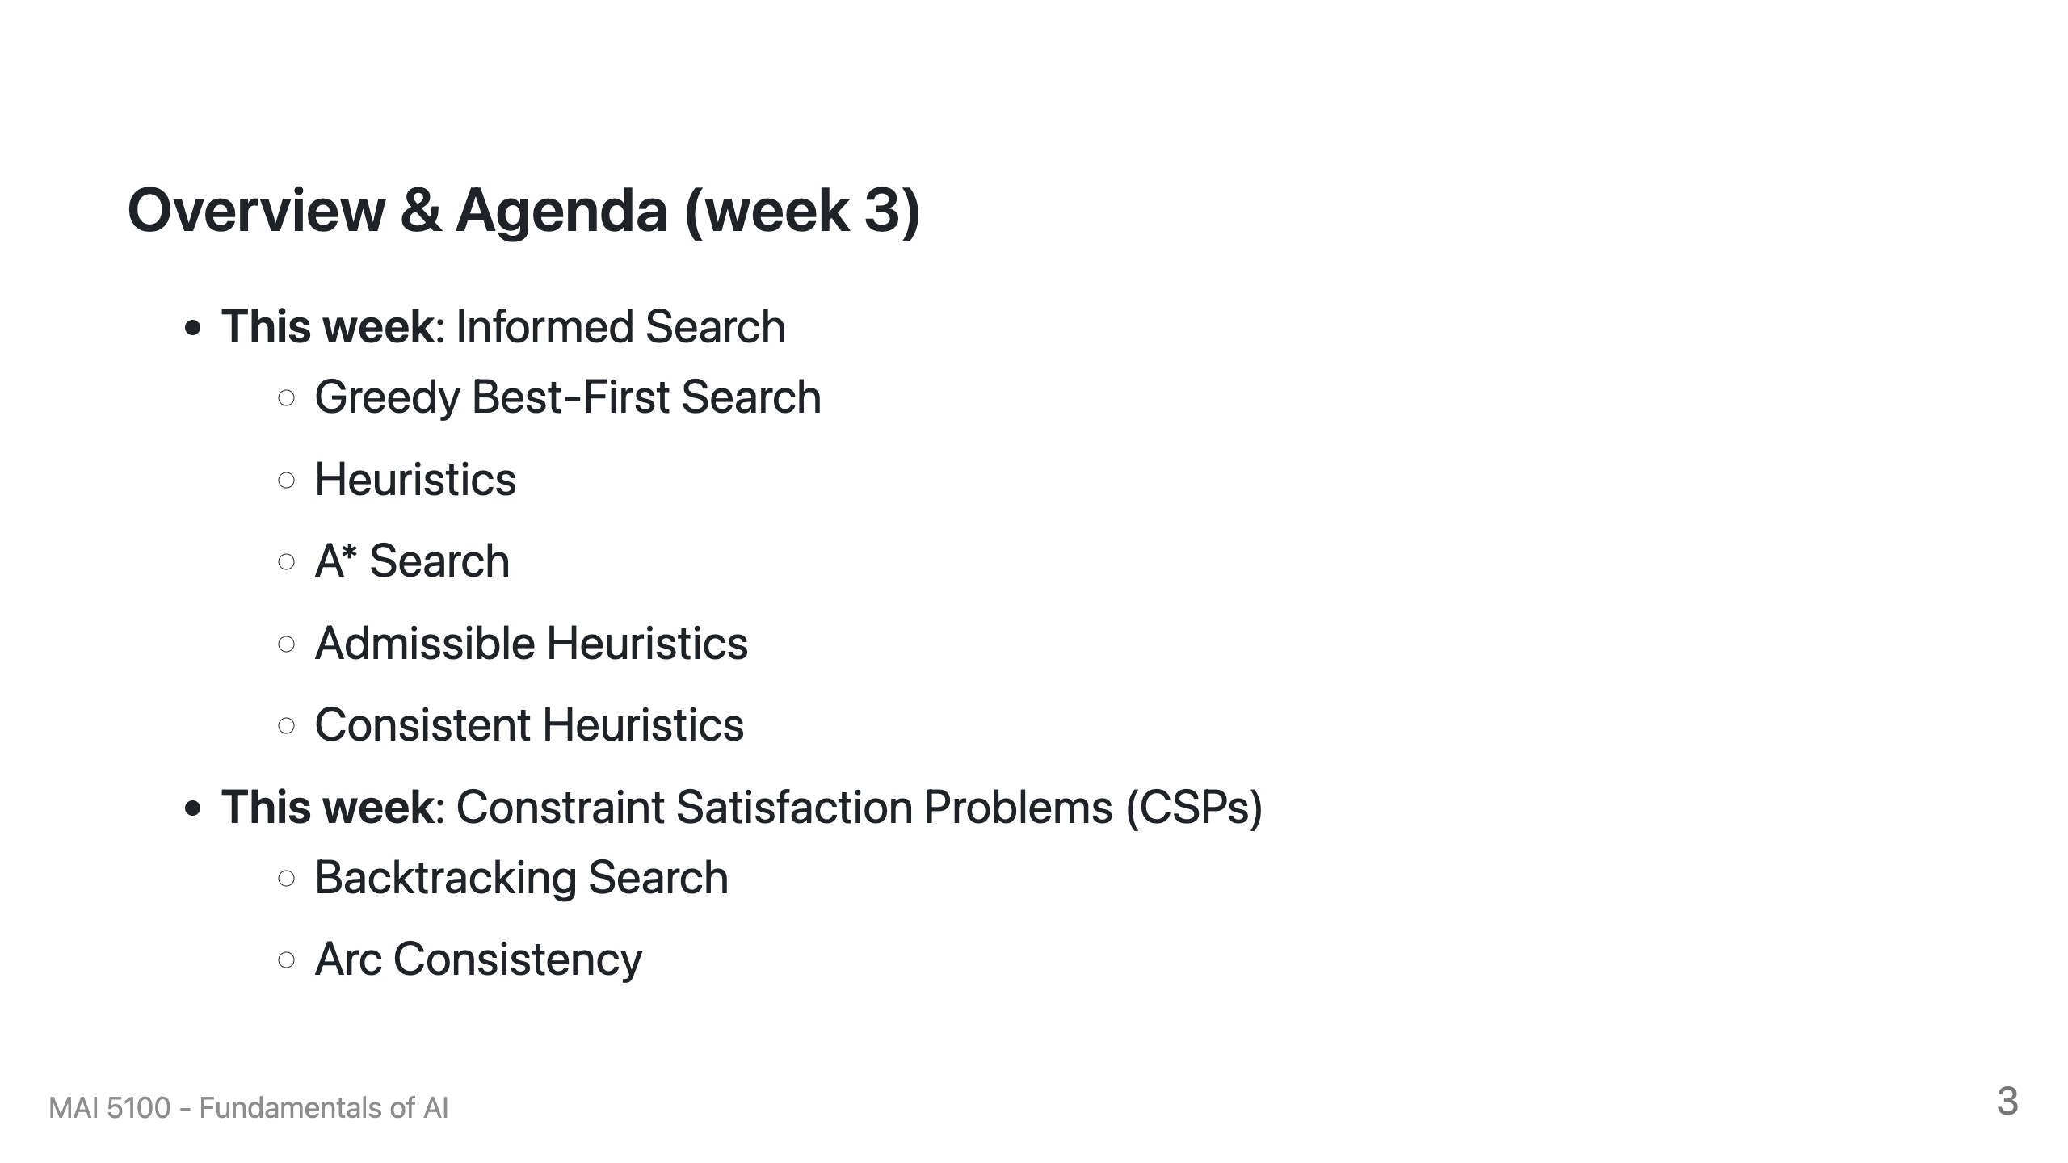

Slide 4

Recap: Search

Slide 5
Recap: Search
Search problem:
States (configurations of the world)
Actions and costs
Successor function (world dynamics)
Start state and goal test
Search tree:
Nodes: represent plans for reaching states
Plans have costs (sum of action costs)
Search algorithm:
Systematically builds a search tree
Chooses an ordering of the fringe (unexplored nodes)
Optimal: finds least-cost plans

Slide 6
Example: Pancake Problem
Cost: Number of pancakes flipped
Notes:
Gates, W. and Papadimitriou, C., "Bounds for Sorting by Prefix Reversal.", Discrete Mathematics. 27, 47-57, 1979.

Slide 7
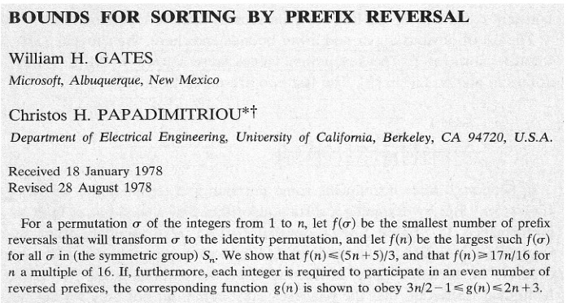
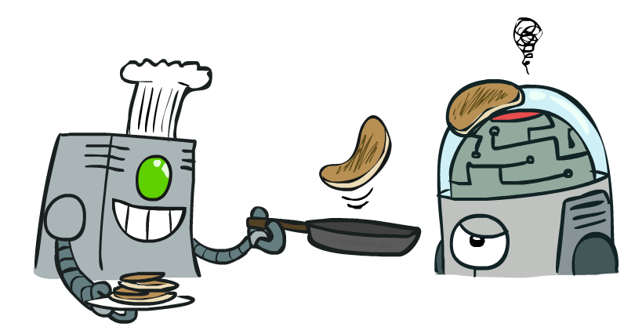
Example: Pancake Problem
Notes:
Gates, W. and Papadimitriou, C., "Bounds for Sorting by Prefix Reversal.", Discrete Mathematics. 27, 47-57, 1979.

Slide 8
Example: Pancake Problem
State space graph with costs as weights
4
2
3
2
3
4
3
4
2
3
2
2
4
3
Notes:
A* expanded 8100 ; Path cost = 33
UCS expanded 25263 . Path cost = 33
Greedy expanded 10 . Path cost = 41
[0, 7, 5, 3, 2, 1, 4, 6]
(7, 0, 5, 3, 2, 1, 4, 6)
(6, 4, 1, 2, 3, 5, 0, 7)
(3, 2, 1, 4, 6, 5, 0, 7)
(1, 2, 3, 4, 6, 5, 0, 7)
(5, 6, 4, 3, 2, 1, 0, 7)
(6, 5, 4, 3, 2, 1, 0, 7)
(0, 1, 2, 3, 4, 5, 6, 7)

Slide 9
General Tree Search
Action: flip top two Cost: 2
Action: flip all four Cost: 4
Path to reach goal:
Flip four, flip three
Total cost: 7
Notes:
You know exactly where you came from and how you got there, but you have no idea where you’re going. But, you’ll know it when you see it.

Slide 10
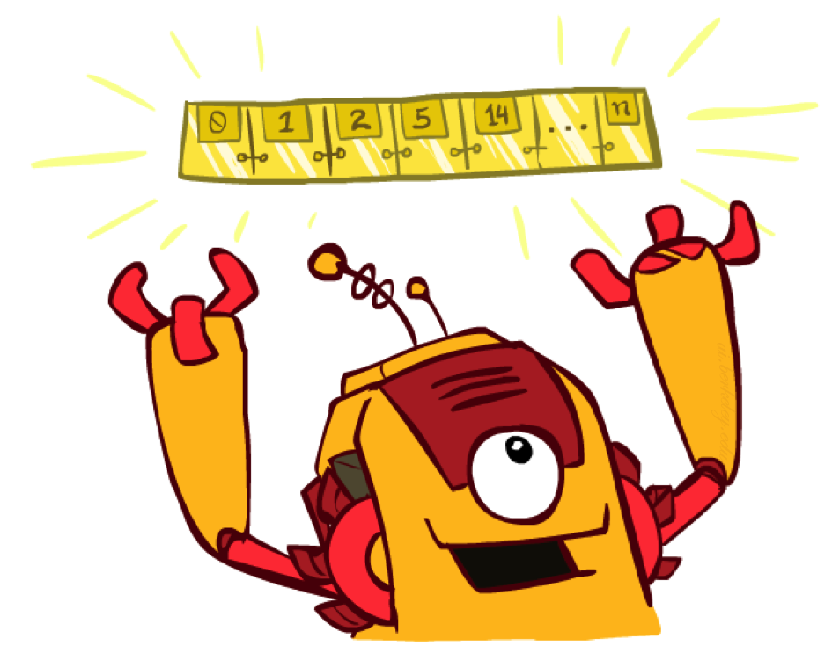
The One Queue
All these search algorithms are the same except for fringe strategies
Conceptually, all fringes are priority queues (i.e. collections of nodes with attached priorities)
Practically, for DFS and BFS, you can avoid the log(n) overhead from an actual priority queue, by using stacks and queues
Can even code one implementation that takes a variable queuing object

Slide 11

Uninformed Search

Slide 12
Uniform Cost Search
Strategy: expand lowest path cost
The good: UCS is complete and optimal!
The bad:
Explores options in every “direction”
No information about goal location
c ≤ 1
…
c ≤ 2
c ≤ 3
Start
Goal
[Demo: contours UCS empty (L3D1)]
[Demo: contours UCS pacman small maze (L3D3)]

Slide 13

Video of Demo Contours UCS Empty

Slide 14
Video of Demo Contours UCS Pacman Small Maze

Slide 15
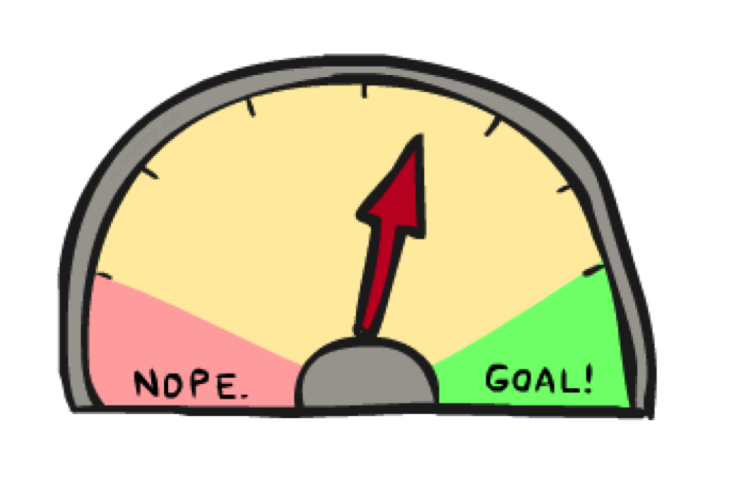
Informed Search

Slide 16



Search Heuristics
A heuristic is:
A function that estimates how close a state is to a goal
Designed for a particular search problem
Examples: Manhattan distance, Euclidean distance for pathing
10
5
11.2

Slide 17
Example: Heuristic Function
h(x)

Slide 18
Example: Heuristic Function
Heuristic: the number of the largest pancake that is still out of place
3
h(x)
4
3
4
3
0
4
4
3
4
4
2
3
Notes:
A* expanded 8100 ; Path cost = 33
UCS expanded 25263 . Path cost = 33
Greedy expanded 10 . Path cost = 41
[0, 7, 5, 3, 2, 1, 4, 6]
(7, 0, 5, 3, 2, 1, 4, 6)
(6, 4, 1, 2, 3, 5, 0, 7)
(3, 2, 1, 4, 6, 5, 0, 7)
(1, 2, 3, 4, 6, 5, 0, 7)
(5, 6, 4, 3, 2, 1, 0, 7)
(6, 5, 4, 3, 2, 1, 0, 7)
(0, 1, 2, 3, 4, 5, 6, 7)

Slide 19

Greedy Search

Slide 20
Example: Heuristic Function
h(x)

Slide 21
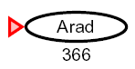

Greedy Search
Expand the node that seems closest…
What can go wrong?

Slide 22
Greedy Search
b
Strategy: expand a node that you think is closest to a goal state
Heuristic: estimate of distance to nearest goal for each state
A common case:
Best-first takes you straight to the (wrong) goal
Worst-case: like a badly-guided DFS
…
b
…
[Demo: contours greedy empty (L3D1)]
[Demo: contours greedy pacman small maze (L3D4)]
Notes:
For any search problem, you know the goal. Now, you have an idea of how far away you are from the goal.

Slide 23
Video of Demo Contours Greedy (Empty)

Slide 24
Video of Demo Contours Greedy (Pacman Small Maze)

Slide 25
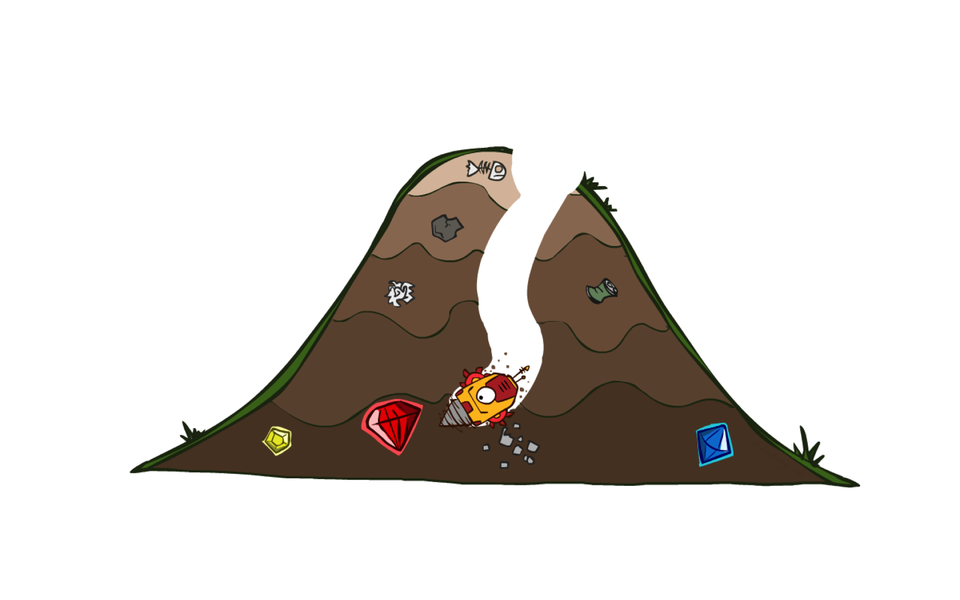
A* Search

Slide 26
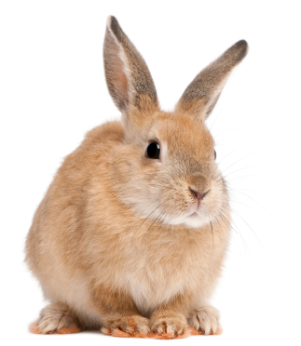
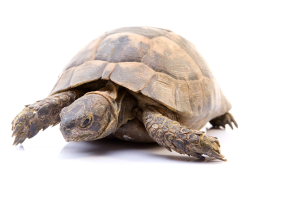

A* Search
UCS
Greedy
A*
Notes:
Notes: these images licensed from iStockphoto for UC Berkeley use.

Slide 27
Combining UCS and Greedy
Uniform-cost orders by path cost, or backward cost g(n)
Greedy orders by goal proximity, or forward cost h(n)
A* Search orders by the sum: f(n) = g(n) + h(n)
8
g = 0 h=6
S
e
h=1
g = 1 h=5
a
1
1
3
2
g = 2 h=6
g = 9 h=1
S
a
d
G
b
d
g = 4 h=2
e
h=6
1
h=5
h=2
h=0
1
g = 3 h=7
g = 6 h=0
g = 10 h=2
c
b
c
G
d
h=7
h=6
g = 12 h=0
G
Example: Teg Grenager

Slide 28
When should A* terminate?
Should we stop when we enqueue a goal?
No: only stop when we dequeue a goal
h = 2
A
2
2
S
h = 3
h = 0
G
2
B
3
h = 1

Slide 29
Is A* Optimal?
h = 6
1
A
3
S
h = 7
G
h = 0
5
What went wrong?
Actual bad goal cost < estimated good goal cost
We need estimates to be less than actual costs!

Slide 30

Admissible Heuristics

Slide 31

Idea: Admissibility
Inadmissible (pessimistic) heuristics break optimality by trapping good plans on the fringe
Admissible (optimistic) heuristics slow down bad plans but never outweigh true costs

Slide 32


Admissible Heuristics
A heuristic h is admissible (optimistic) if:
where is the true cost to a nearest goal
Examples:
Coming up with admissible heuristics is most of what’s involved in using A* in practice.
4
15

Slide 33

Optimality of A* Tree Search

Slide 34


Optimality of A* Tree Search
Assume:
A is an optimal goal node
B is a suboptimal goal node
h is admissible
Claim:
A will exit the fringe before B
…

Slide 35



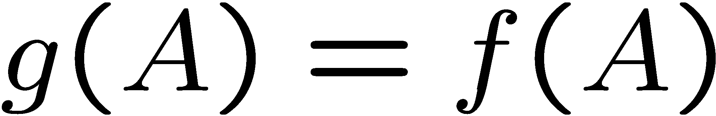
Optimality of A* Tree Search: Blocking
Proof:
Imagine B is on the fringe
Some ancestor n of A is on the fringe, too (maybe A!)
Claim: n will be expanded before B
f(n) is less or equal to f(A)
…
Definition of f-cost
Admissibility of h
h = 0 at a goal

Slide 36
Optimality of A* Tree Search: Blocking
1. f(n) is less than or equal to f(A)
▪ Definition of f-cost says:
f(n) = g(n) + h(n) = (path cost to n) + (est. cost of n to A)
f(A) = g(A) + h(A) = (path cost to A) + (est. cost of A to A)
▪ The admissible heuristic must underestimate the true cost
h(A) = (est. cost of A to A) = 0
▪ So now, we have to compare:
f(n) = g(n) + h(n) = (path cost to n) + (est. cost of n to A)
f(A) = g(A) = (path cost to A)
▪ h(n) must be an underestimate of the true cost from n to A
(path cost to n) + (est. cost of n to A) ≤ (path cost to A)
g(n) + h(n) ≤ g(A)
f(n) ≤ f(A)
…

Slide 37


Optimality of A* Tree Search: Blocking
Proof:
Imagine B is on the fringe
Some ancestor n of A is on the fringe, too (maybe A!)
Claim: n will be expanded before B
f(n) is less or equal to f(A)
f(A) is less than f(B)
…
B is suboptimal
h = 0 at a goal

Slide 38
Optimality of A* Tree Search: Blocking
2. f(A) is less than f(B)
▪ We know that:
f(A) = g(A) + h(A) = (path cost to A) + (est. cost of A to A)
f(B) = g(B) + h(B) = (path cost to B) + (est. cost of B to B)
▪ The heuristic must underestimate the true cost:
h(A) = h(B) = 0
▪ So now, we have to compare:
f(A) = g(A) = (path cost to A)
f(B) = g(B) = (path cost to B)
▪ We assumed that B is suboptimal! So
(path cost to A) < (path cost to B)
g(A) < g(B)
f(A) < f(B)
…

Slide 39

Optimality of A* Tree Search: Blocking
Proof:
Imagine B is on the fringe
Some ancestor n of A is on the fringe, too (maybe A!)
Claim: n will be expanded before B
f(n) is less or equal to f(A)
f(A) is less than f(B)
n expands before B
All ancestors of A expand before B
A expands before B
A* search is optimal
…

Slide 40
Properties of A*

Slide 41
Properties of A*
Uniform-Cost
A*
b
b
…
…

Slide 42
UCS vs A* Contours
Uniform-cost expands equally in all “directions”
A* expands mainly toward the goal, but does hedge its bets to ensure optimality
Start
Goal
Start
Goal
[Demo: contours UCS / greedy / A* empty (L3D1)]
[Demo: contours A* pacman small maze (L3D5)]

Slide 43
Video of Demo Contours (Empty) -- UCS

Slide 44
Video of Demo Contours (Empty) -- Greedy

Slide 45
Video of Demo Contours (Empty) – A*

Slide 46
Video of Demo Contours (Pacman Small Maze) – A*

Slide 47



Comparison
Greedy
Uniform Cost
A*

Slide 48
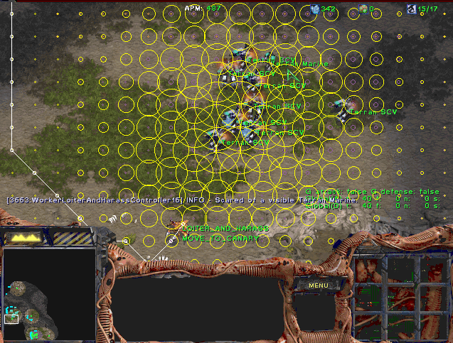
A* Applications

Slide 49
A* Applications
Video games
Pathing / routing problems
Resource planning problems
Robot motion planning
Language analysis
Machine translation
Speech recognition
…
[Demo: UCS / A* pacman tiny maze (L3D6,L3D7)]
[Demo: guess algorithm Empty Shallow/Deep (L3D8)]

Slide 50
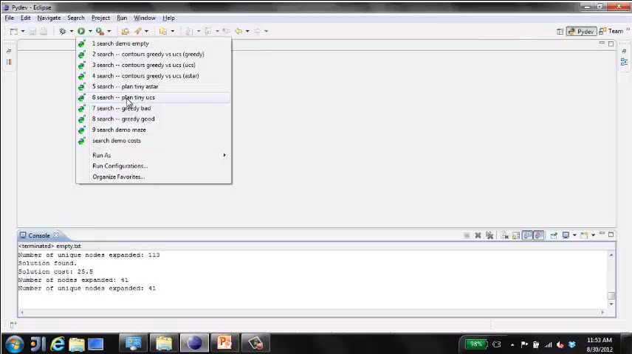
Video of Demo Pacman (Tiny Maze) – UCS / A*

Slide 51
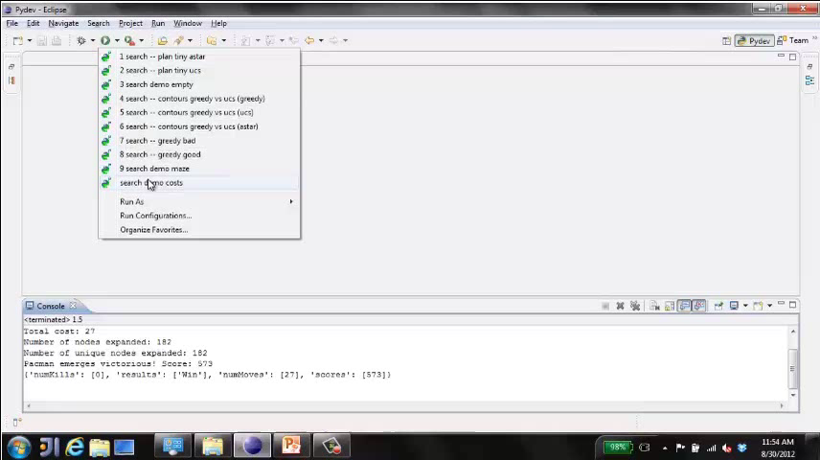
Video of Demo Empty Water Shallow/Deep – Guess Algorithm

Slide 52

Creating Heuristics

Slide 53
Creating Admissible Heuristics
Most of the work in solving hard search problems optimally is in coming up with admissible heuristics
Often, admissible heuristics are solutions to relaxed problems, where new actions are available
Inadmissible heuristics are often useful too
366
15

Slide 54
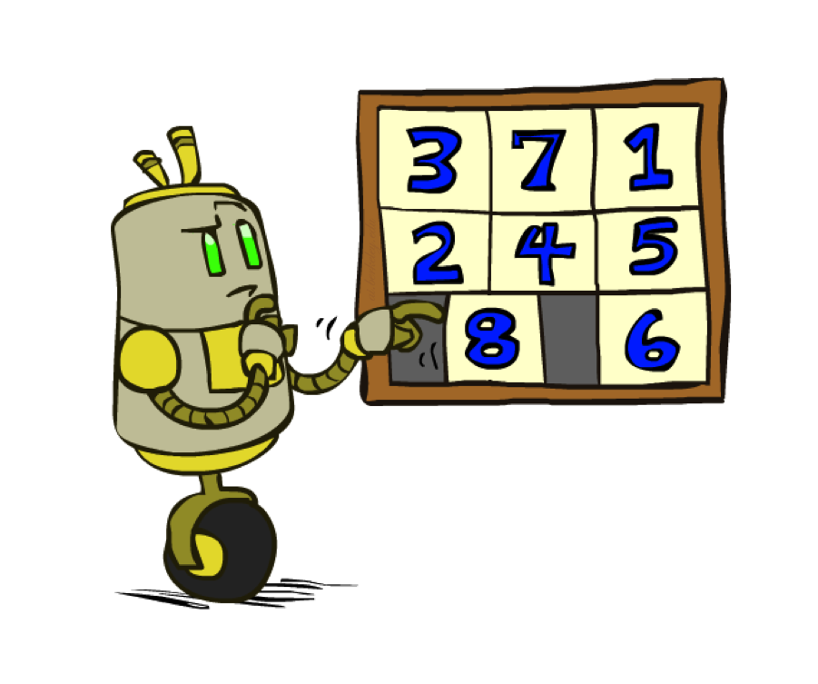
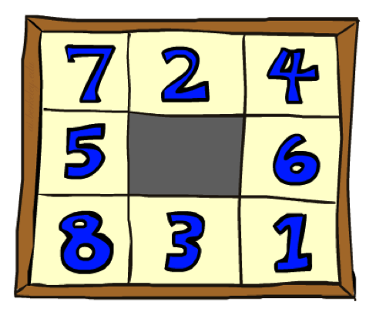
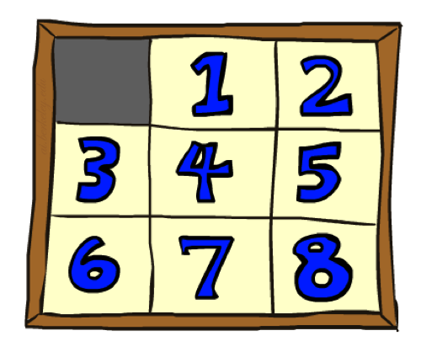
Example: 8 Puzzle
Start State
Actions
Goal State
What are the states?
How many states?
What are the actions?
How many successors from the start state?
What should the costs be?

Slide 55
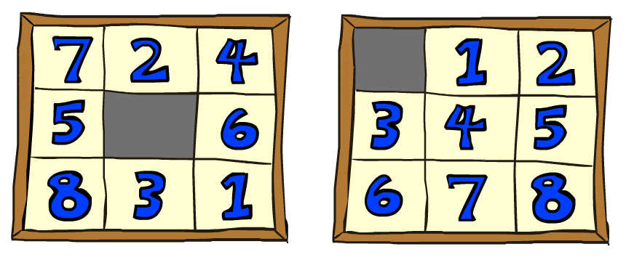
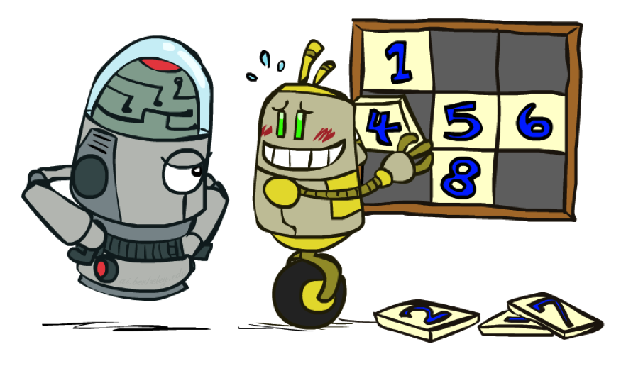
8 Puzzle I
Heuristic: Number of tiles misplaced
Why is it admissible?
h(start) =
This is a relaxed-problem heuristic
8
Start State
Goal State
 | Average nodes expanded when the optimal path has…
 | …4 steps | …8 steps | …12 steps
UCS | 112 | 6,300 | 3.6 x 10⁶
TILES | 13 | 39 | 227
Statistics from Andrew Moore

Slide 56
8 Puzzle II
What if we had an easier 8-puzzle where any tile could slide any direction at any time, ignoring other tiles?
Total Manhattan distance
Why is it admissible?
h(start) =
Start State
Goal State
 | Average nodes expanded when the optimal path has…
 | …4 steps | …8 steps | …12 steps
TILES | 13 | 39 | 227
MANHATTAN | 12 | 25 | 73
3 + 1 + 2 + … = 18

Slide 57
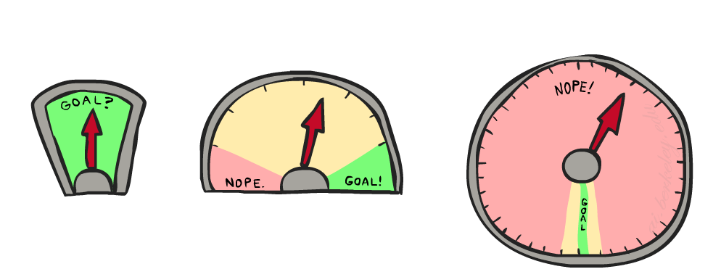
8 Puzzle III
How about using the actual cost as a heuristic?
Would it be admissible?
Would we save on nodes expanded?
What’s wrong with it?
With A*: a trade-off between quality of estimate and work per node
As heuristics get closer to the true cost, you will expand fewer nodes but usually do more work per node to compute the heuristic itself

Slide 58
Semi-Lattice of Heuristics

Slide 59

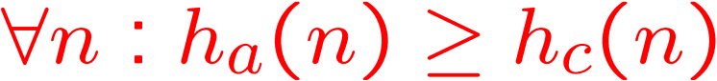
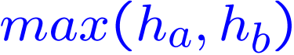

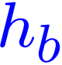


Trivial Heuristics, Dominance
Dominance: h_{a} ≥ h_{c} if
Heuristics form a semi-lattice:
Max of admissible heuristics is admissible
Trivial heuristics
Bottom of lattice is the zero heuristic (what does this give us?)
Top of lattice is the exact heuristic
Notes:
Semi-lattice: x <= y <-> x = x ^ y

Slide 60
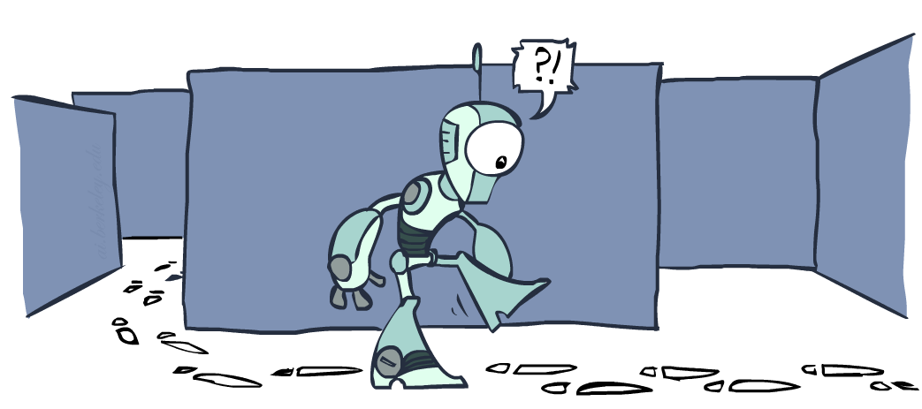
Graph Search

Slide 61
Tree Search: Extra Work!
Failure to detect repeated states can cause exponentially more work.
State Graph
Search Tree

Slide 62
Graph Search
In BFS, for example, we shouldn’t bother expanding the circled nodes (why?)
S
d
e
p
b
c
e
h
r
q
a
a
h
r
p
q
f
p
q
f
q
c
G
q
c
G
a
a

Slide 63
Graph Search
Idea: never expand a state twice
How to implement:
Tree search + set of expanded states (“closed set”)
Expand the search tree node-by-node, but…
Before expanding a node, check to make sure its state has never been expanded before
If not new, skip it, if new add to closed set
Important: store the closed set as a set, not a list
Can graph search wreck completeness? Why/why not?
How about optimality?

Slide 64
A* Graph Search Gone Wrong?
State space graph
Search tree
A
S (0+2)
1
S
1
C
h=4
h=1
A (1+4)
B (1+1)
h=2
1
2
B
3
C (2+1)
C (3+1)
h=1
G
G (5+0)
G (6+0)
h=0

Slide 65
Consistency of Heuristics
Main idea: estimated heuristic costs ≤ actual costs
Admissibility: heuristic cost ≤ actual cost to goal
h(A) ≤ actual cost from A to G
Consistency: heuristic “arc” cost ≤ actual cost for each arc
h(A) – h(C) ≤ cost(A to C)
Consequences of consistency:
The f value along a path never decreases
h(A) ≤ cost(A to C) + h(C)
A* graph search is optimal
A
1
C
h=4
h=1
h=2
3
G

Slide 66
Optimality of A* Graph Search

Slide 67
Optimality of A* Graph Search
Sketch: consider what A* does with a consistent heuristic:
Fact 1: In tree search, A* expands nodes in increasing total f value (f-contours)
Fact 2: For every state s, nodes that reach s optimally are expanded before nodes that reach s suboptimally
Result: A* graph search is optimal
…
f ≤ 1
f ≤ 2
f ≤ 3

Slide 68
Optimality
Tree search:
A* is optimal if heuristic is admissible
UCS is a special case (h = 0)
Graph search:
A* optimal if heuristic is consistent
UCS optimal (h = 0 is consistent)
Consistency implies admissibility
In general, most natural admissible heuristics tend to be consistent, especially if from relaxed problems

Slide 69

A*: Summary

Slide 70

A*: Summary
A* uses both backward costs and (estimates of) forward costs
A* is optimal with admissible / consistent heuristics
Heuristic design is key: often use relaxed problems

Slide 71
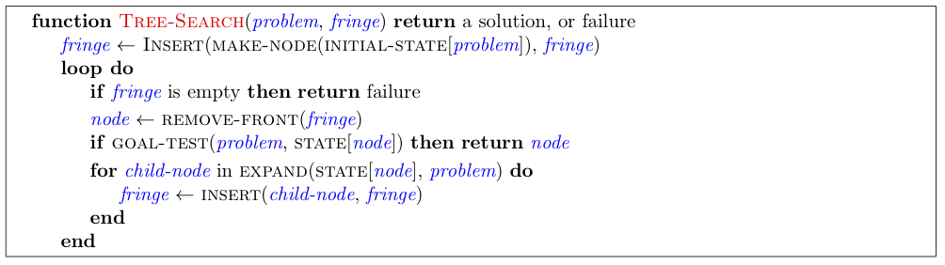
Tree Search Pseudo-Code

Slide 72
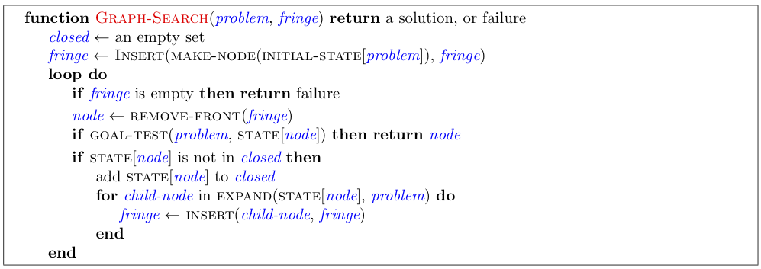
Graph Search Pseudo-Code

Slide 73
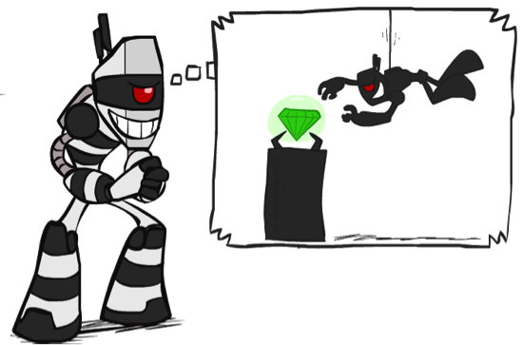

What is Search For?
Assumptions about the world: a single agent, deterministic actions, fully observed state, discrete state space
Planning: sequences of actions
The path to the goal is the important thing
Paths have various costs, depths
Heuristics give problem-specific guidance
Identification: assignments to variables
The goal itself is important, not the path
All paths at the same depth (for some formulations)
CSPs are specialized for identification problems

Slide 74

Constraint Satisfaction Problems

Slide 75


Constraint Satisfaction Problems
Standard search problems:
State is a “black box”: arbitrary data structure
Goal test can be any function over states
Successor function can also be anything
Constraint satisfaction problems (CSPs):
A special subset of search problems
State is defined by variables X_{i} with values from a domain D (sometimes D depends on i)
Goal test is a set of constraints specifying allowable combinations of values for subsets of variables
Simple example of a formal representation language
Allows useful general-purpose algorithms with more power than standard search algorithms
Notes:
Goal test has structure, it ‘s more like a manual describing a set of constraints that have to hold true

Slide 76
CSP Examples

Slide 77


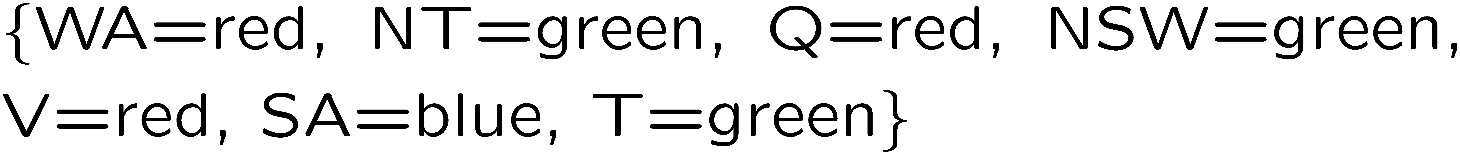
Example: Map Coloring
Variables:
Domains:
Constraints: adjacent regions must have different colors
Solutions are assignments satisfying all constraints, e.g.:
Implicit:
Explicit:

Slide 78
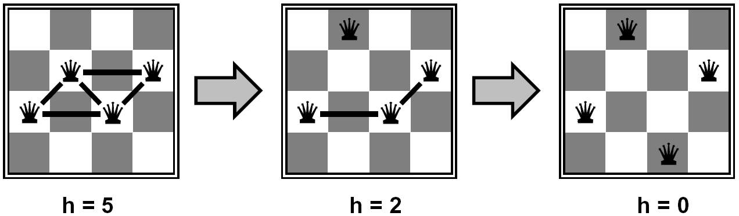
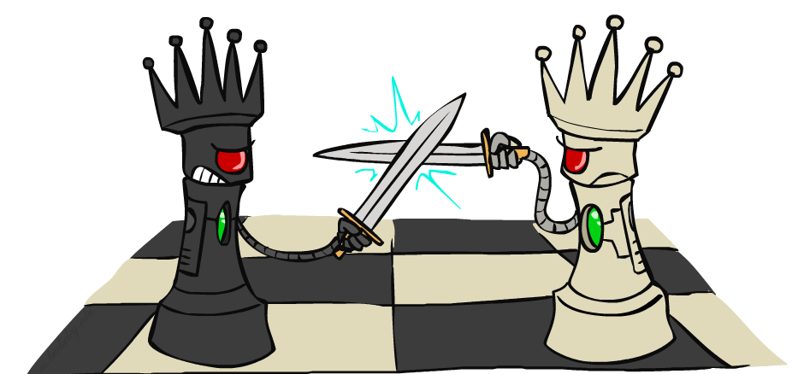
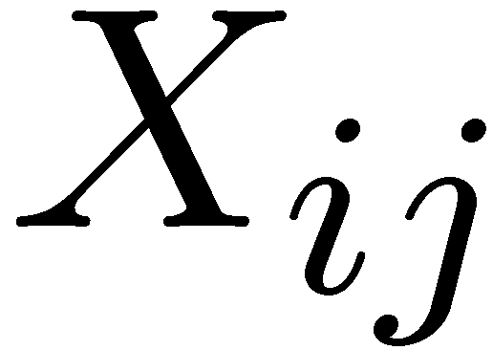

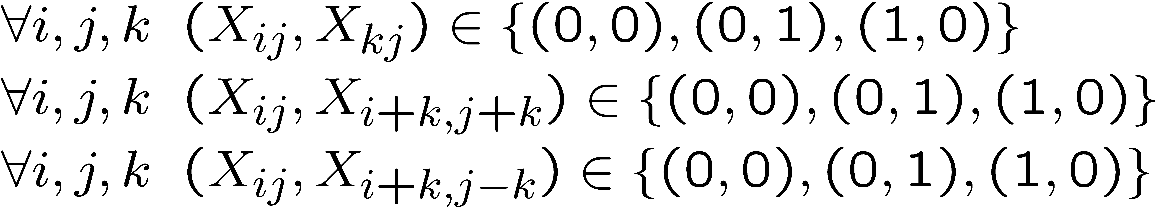
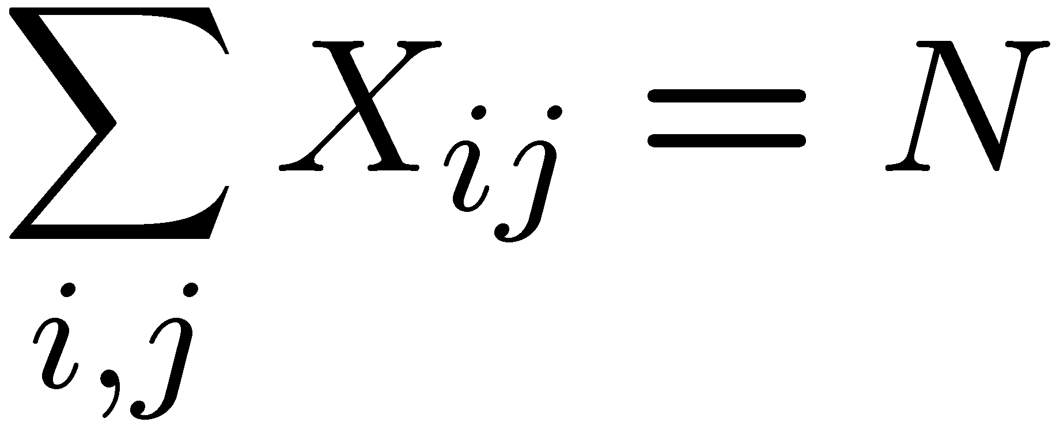
Example: N-Queens
Formulation 1:
Variables:
Domains:
Constraints

Slide 79

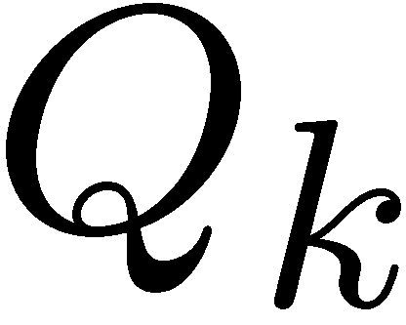


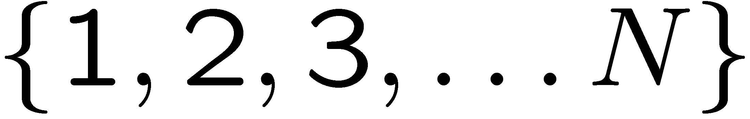


Example: N-Queens
Formulation 2:
Variables:
Domains:
Constraints:
Implicit:
Explicit:

Slide 80
Constraint Graphs

Slide 81
Constraint Graphs
Binary CSP: each constraint relates (at most) two variables
Binary constraint graph: nodes are variables, arcs show constraints
General-purpose CSP algorithms use the graph structure to speed up search. E.g., Tasmania is an independent subproblem!
[Demo: CSP applet (made available by aispace.org) -- n-queens]
Notes:
Demo:
Run constraint.jar or constraint.exe, load the 5 queens problem.
Demo is just showing the n-queens applet as illustration of constraint graph, but later in lecture we’ll interact with the applet.
aispace.org will have the latest version

Slide 82
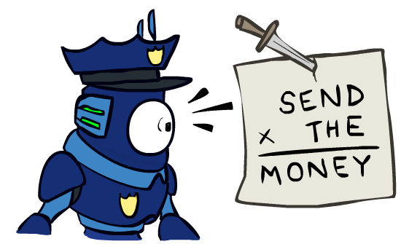

Example: Cryptarithmetic
Variables:
Domains:
Constraints:
Notes:
0=7, R=4, W=6, U=2, T=8, F=1; 867 + 867 = 1734

Slide 83
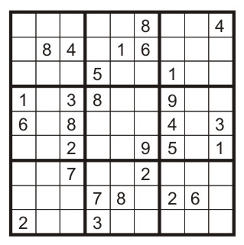
Example: Sudoku
Variables:
Each (open) square
Domains:
{1,2,…,9}
Constraints:
9-way alldiff for each column
9-way alldiff for each row
9-way alldiff for each region
(or can have a bunch of pairwise inequality constraints)

Slide 84
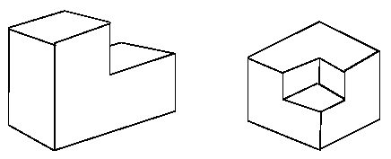
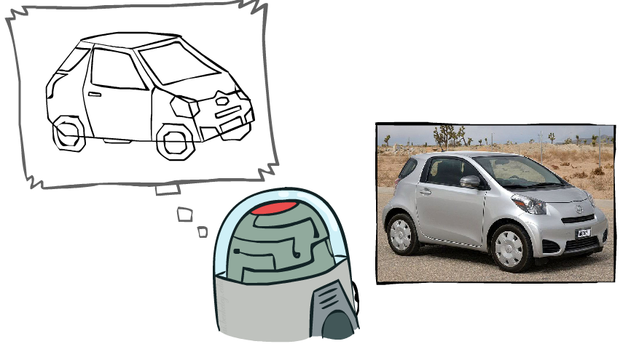
Example: The Waltz Algorithm
The Waltz algorithm is for interpreting line drawings of solid polyhedra as 3D objects
An early example of an AI computation posed as a CSP
?
Approach:
Each intersection is a variable
Adjacent intersections impose constraints on each other
Solutions are physically realizable 3D interpretations

Slide 85
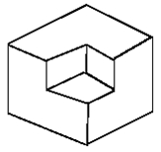
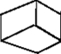
Example: The Waltz Algorithm
The Waltz algorithm is for interpreting line drawings of solid polyhedra as 3D objects
An early example of an AI computation posed as a CSP
?
Approach:
Each intersection is a variable
Adjacent intersections impose constraints on each other
Solutions are physically realizable 3D interpretations

Slide 86
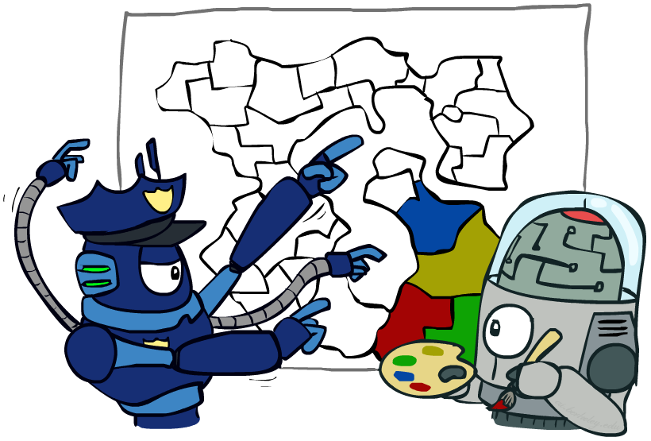
Varieties of CSPs and Constraints

Slide 87


Varieties of CSPs
Discrete Variables
Finite domains
Size d means O(d^{n}) complete assignments
E.g., Boolean CSPs, including Boolean satisfiability (NP-complete)
Infinite domains (integers, strings, etc.)
E.g., job scheduling, variables are start/end times for each job
Linear constraints solvable, nonlinear undecidable
Continuous variables
E.g., start/end times for Hubble Telescope observations
Linear constraints solvable in polynomial time by LP methods (see cs170 for a bit of this theory)

Slide 88


Varieties of Constraints
Varieties of Constraints
Unary constraints involve a single variable (equivalent to reducing domains), e.g.:
Binary constraints involve pairs of variables, e.g.:
Higher-order constraints involve 3 or more variables:
e.g., cryptarithmetic column constraints
Preferences (soft constraints):
E.g., red is better than green
Often representable by a cost for each variable assignment
Gives constrained optimization problems
(We’ll ignore these until we get to Bayes’ nets)

Slide 89
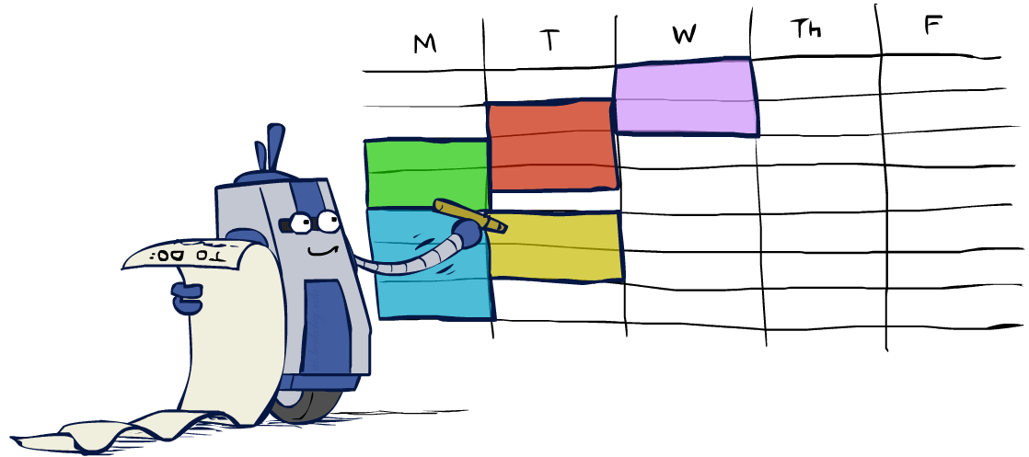
Real-World CSPs
Assignment problems: e.g., who teaches what class
Timetabling problems: e.g., which class is offered when and where?
Hardware configuration
Transportation scheduling
Factory scheduling
Circuit layout
Fault diagnosis
… lots more!
Many real-world problems involve real-valued variables…

Slide 90
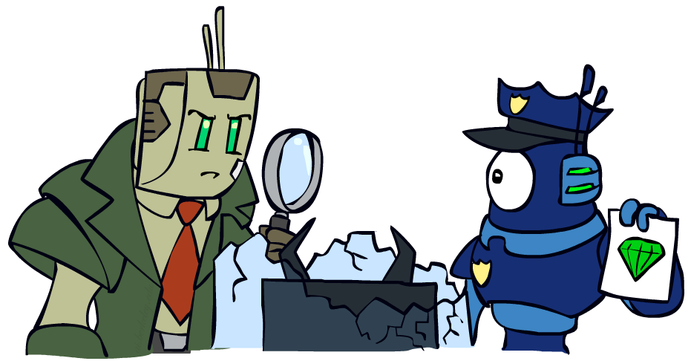
Solving CSPs

Slide 91
Standard Search Formulation
Standard search formulation of CSPs
States defined by the values assigned so far (partial assignments)
Initial state: the empty assignment, {}
Successor function: assign a value to an unassigned variable
Goal test: the current assignment is complete and satisfies all constraints
We’ll start with the straightforward, naïve approach, then improve it

Slide 92
Search Methods
What would BFS do?
What would DFS do?
What problems does naïve search have?
[Demo: coloring -- dfs]
Notes:
Demo:
CS188 javascript demos -> source -> exercises -> csps -> CSPs demos -> CSPs demos.html
Settings:
Graph = Simple
Algorithm = Naïve Search
Ordering = None
Filtering = None

Slide 93
Video of Demo Coloring -- DFS

Slide 94

Backtracking Search

Slide 95
Backtracking Search
Backtracking search is the basic uninformed algorithm for solving CSPs
Idea 1: One variable at a time
Variable assignments are commutative, so fix ordering
I.e., [WA = red then NT = green] same as [NT = green then WA = red]
Only need to consider assignments to a single variable at each step
Idea 2: Check constraints as you go
I.e. consider only values which do not conflict previous assignments
Might have to do some computation to check the constraints
“Incremental goal test”
Depth-first search with these two improvements
is called backtracking search (not the best name)
Can solve n-queens for n ≈ 25

Slide 96
Backtracking Example

Slide 97
Backtracking Search
Backtracking = DFS + variable-ordering + fail-on-violation
What are the choice points?
[Demo: coloring -- backtracking]
Notes:
Demo:
CS188 javascript demos -> source -> exercises -> csps -> CSPs demos -> CSPs demos.html
Settings:
Graph = Simple
Algorithm = Backtracking
Ordering = None
Filtering = None

Slide 98
Video of Demo Coloring – Backtracking

Slide 99
Improving Backtracking
General-purpose ideas give huge gains in speed
Ordering:
Which variable should be assigned next?
In what order should its values be tried?
Filtering: Can we detect inevitable failure early?
Structure: Can we exploit the problem structure?

Slide 100
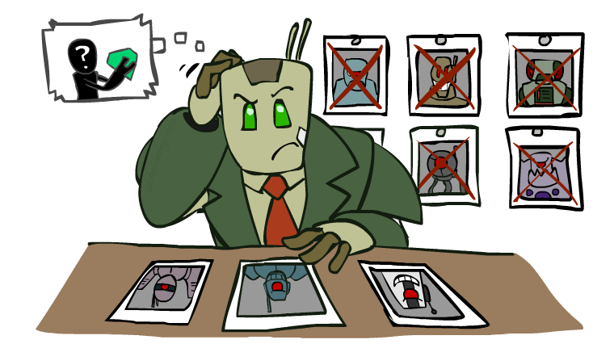
Filtering

Slide 101
Filtering: Forward Checking
Filtering: Keep track of domains for unassigned variables and cross off bad options
Forward checking: Cross off values that violate a constraint when added to the existing assignment
WA
NT
Q
SA
NSW
V
[Demo: coloring -- forward checking]
Notes:
Demo:
CS188 javascript demos -> source -> exercises -> csps -> CSPs demos -> CSPs demos.html
Settings:
Graph = Simple
Algorithm = Backtracking
Ordering = None
Filtering = Forward Checking

Slide 102
Video of Demo Coloring – Backtracking with Forward Checking

Slide 103
Filtering: Constraint Propagation
Forward checking propagates information from assigned to unassigned variables, but doesn't provide early detection for all failures:
NT and SA cannot both be blue!
Why didn’t we detect this yet?
Constraint propagation: reason from constraint to constraint
NT
Q
WA
SA
NSW
V

Slide 104
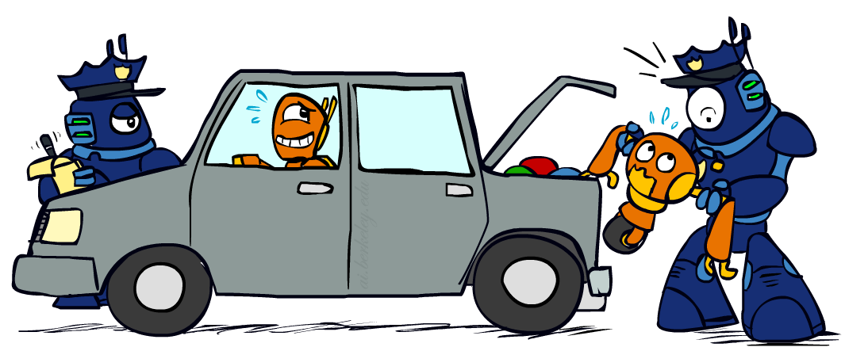
Consistency of A Single Arc
An arc X → Y is consistent iff for every x in the tail there is some y in the head which could be assigned without violating a constraint
Forward checking: Enforcing consistency of arcs pointing to each new assignment
NT
Q
WA
SA
NSW
V
Delete from the tail!

Slide 105
Arc Consistency of an Entire CSP
A simple form of propagation makes sure all arcs are consistent:
Important: If X loses a value, neighbors of X need to be rechecked!
Arc consistency detects failure earlier than forward checking
Can be run as a preprocessor or after each assignment
What’s the downside of enforcing arc consistency?
NT
Q
WA
SA
NSW
V
Remember: Delete from the tail!

Slide 106
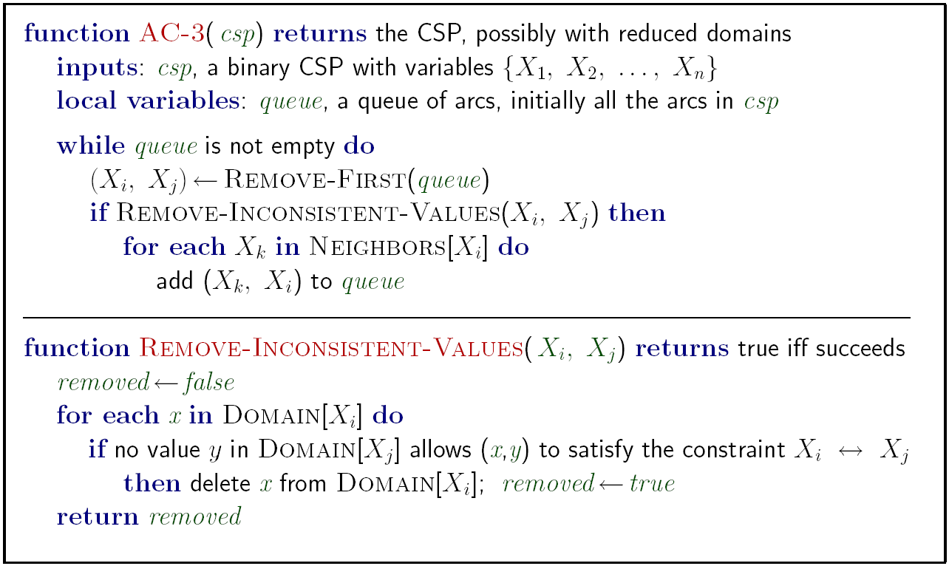
Enforcing Arc Consistency in a CSP
Runtime: O(n²d³), can be reduced to O(n²d²)
… but detecting all possible future problems is NP-hard – why?
[Demo: CSP applet (made available by aispace.org) -- n-queens]
Notes:
Auto-consistency (note initially nothing gets deleted/pruned since there are consistent options for all constraints for initial variable domains)
Flashes whenever something needs to be re-checked

Slide 107
Video of Demo Arc Consistency – CSP Applet – n Queens

Slide 108
Limitations of Arc Consistency
After enforcing arc consistency:
Can have one solution left
Can have multiple solutions left
Can have no solutions left (and not know it)
Arc consistency still runs inside a backtracking search!
What went wrong here?
[Demo: coloring -- forward checking]
[Demo: coloring -- arc consistency]
Notes:
Demo:
CS188 javascript demos -> source -> exercises -> csps -> CSPs demos -> CSPs demos.html
Settings:
Graph = Complex
Algorithm = Backtracking
Ordering = None
Filtering = Forward Checking (first) / Arc Consistency (second)

Slide 109
Video of Demo Coloring – Backtracking with Forward Checking – Complex Graph

Slide 110
Video of Demo Coloring – Backtracking with Arc Consistency – Complex Graph

Slide 111
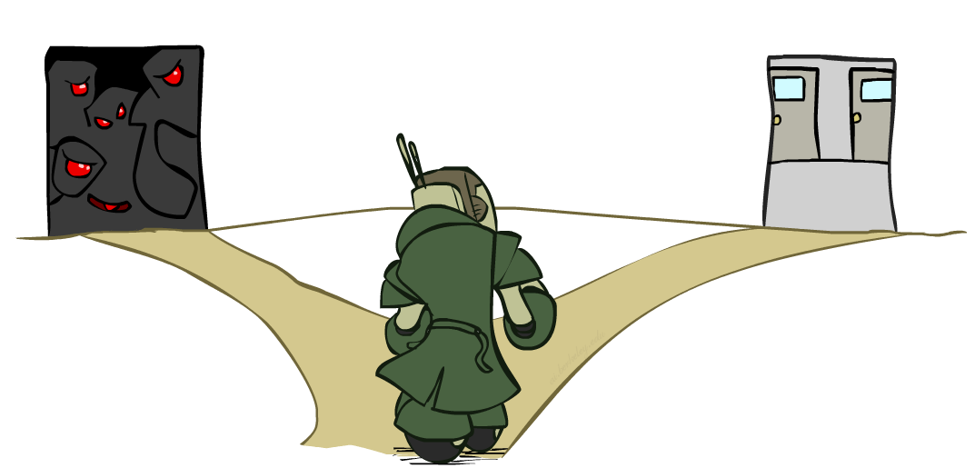
Ordering

Slide 112
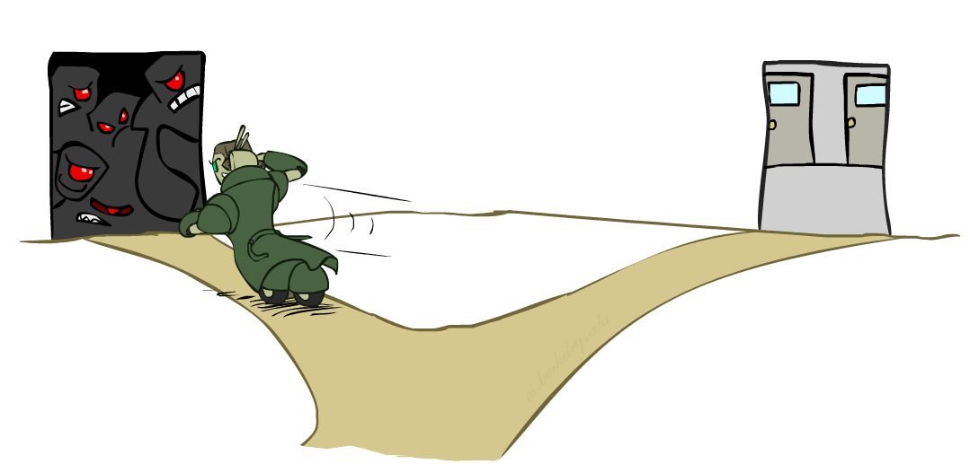
Ordering: Minimum Remaining Values
Variable Ordering: Minimum remaining values (MRV):
Choose the variable with the fewest legal left values in its domain
Why min rather than max?
Also called “most constrained variable”
“Fail-fast” ordering

Slide 113
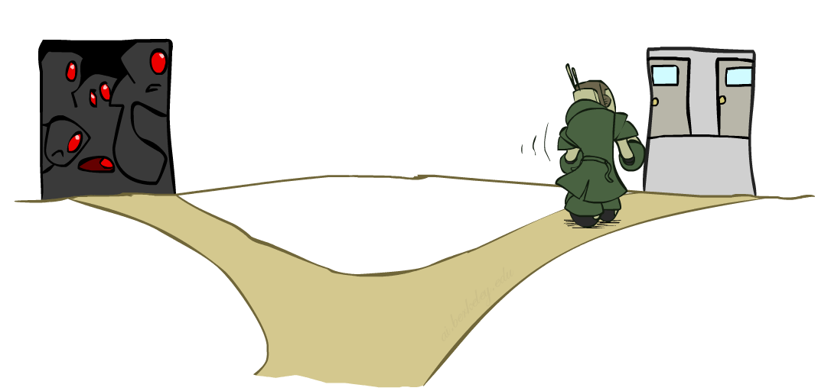
Ordering: Least Constraining Value
Value Ordering: Least Constraining Value
Given a choice of variable, choose the least constraining value
I.e., the one that rules out the fewest values in the remaining variables
Note that it may take some computation to determine this! (E.g., rerunning filtering)
Why least rather than most?
Combining these ordering ideas makes
1000 queens feasible

Slide 114
Demo: Coloring -- Backtracking + Forward Checking + Ordering
Notes:
Demo:
CS188 javascript demos -> source -> exercises -> csps -> CSPs demos -> CSPs demos.html
Settings:
Graph = Complex
Algorithm = Backtracking
Ordering = MRV
Filtering = Forward Checking
Solves already without any need for backtracking
Note: need a bigger problem to illustrate relevance of backtracking+AC+MRV+MCV

